Slide 1
Introductory To Programming and
Problem-Solving Skills
Data and Expression
Tutorial Week - 2
Bhisma Raj Koirala

Slide 2
Agenda
Introduction
Python Literals
Python Variables
Python Data Types
Type Casting
Python Operators
Python I/O
Bonus Topic

Slide 3
Let’s Think Data
Let’s pick a random literals and operators from random picker and discuss about the data type and its implementation in real time code.

Slide 4
What is Python?
Python is an interpreted, object oriented, high level, cross platform programming language with dynamic semantics developed by Guido van Rossum
Developing websites and software, task automation, data analysis and data visualization used by many successful organization.
Note: Students will be provided 10 minutes to gather around data and its implementation. After 10 minutes of time, tutor will conduct a session where students are selected randomly and asked to discuss about it.

Slide 5

By now, you may have installed python so now let’s implement.

Slide 6
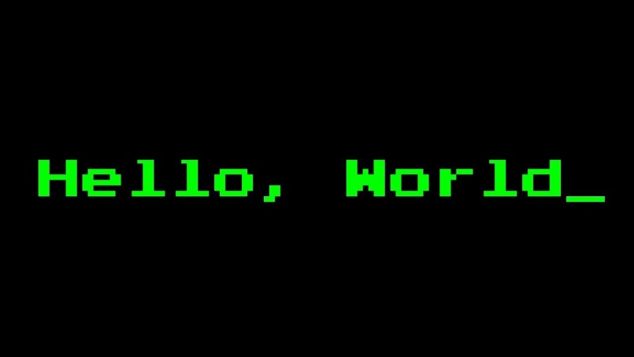
Run the first program
print(“Hello, World_”)
Output: Hello, World_
print(“Hello World123!”)
Output: Hello World123!
OBSERVE
QUESTION?
THINK

Slide 7
Python Literals
What are Python Literals?
In python, data are categorized into different form which we refer as literals.
Literals are representation of fixed value in a program.
They can be numbers, strings, Boolean and so on.

Slide 8
Literals and Its Implementation
Numeric Literals: int, float and complex
String Literals: str
Boolean Literals: True and False
Collection Literals: list, tuple, set and dict
Special Literal: None

Slide 9

Do we use values directly in the calculation/program?

Slide 10
Python Variables
What are Variables?
A variable is a name (identifier) that is associated with a value and can be used to store data and used in further calculation.

Slide 11
Some ways to declare variable
Assign multiple values to variable
name, age, add = “ram”, 20, “ktm”
print(name)
print(age)
print(add)
Change the value of age1 and 2 variable
age1 = age2 = 20
print(age1)
print(age2)
Assign Ram to a name variable
name = “Ram”
print(name)
Change the value of name variable
name = “Hari”
print(name)
Counter variable
number = 1
number = number + 1

Slide 12
REMEMBER!!!
Rules for Naming an Identifier
Identifiers cannot be a keyword.
Identifiers are case-sensitive.
It can have a sequence of letters and digits.
White Spaces are not allowed.
We cannot use special symbols like !, @, #, $, and so on.
However, it must begin with a letter not with an _. The first letter of an identifier cannot be a digit.
So, what could be the valid and invalid identifiers?

Slide 13
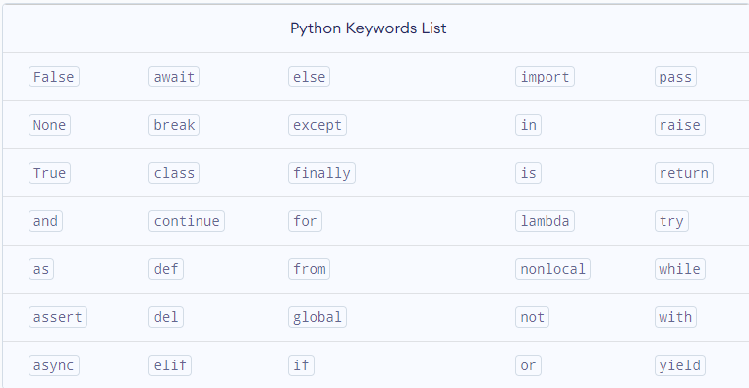
Some Common Python Keywords

Slide 14
Python Data Types
What are Data Types?
Every value belongs to a specific data type in Python. Data type identifies the type of data values a variable can hold and the operations that can be performed on that data
We can use the type() function to know which class a variable or a value belongs to.

Slide 15
Interesting Fact!!
Limits of Range in Floating-Points
A certain number of "digits" (or bits) which can use to represent a number, and if we try to enter a number that's too big or too small, or has too many digits, the number will be rounded off or truncated to fit within the available "digits".
For example, let's say you want to represent the number 100000000000000000000000000000000000. This number is too big to fit within the available bits for a floating-point number, so Python will round it off to the nearest representable number:
x = 100000000000000000000000000000000000.0
print(x)
1e+35
As you can see, Python rounded off the number to 1e+35 (which is scientific notation for 1 x 10^35). This is still a very big number, but it's not the same as the number you tried to enter.

Slide 16


Type Casting
Why do we need type conversion?
Let’s perform a program:
Expected Output??

Slide 17
Python Type Conversion
Type Conversion
Implicit
Explicit
Conversion performed by python interpreter.
Automatic type conversion.
Conversion performed by user explicitly using type conversion function.
Manual type conversion

Slide 18
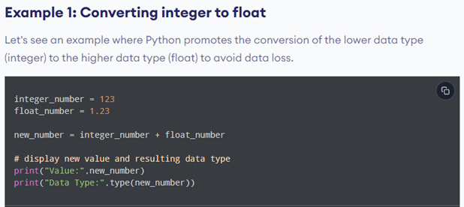
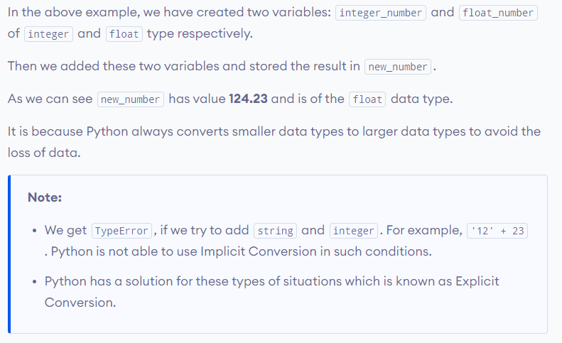

Implicit Conversion

Slide 19
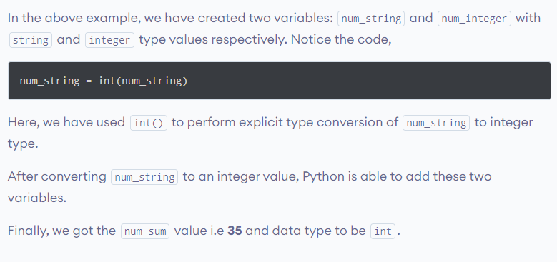
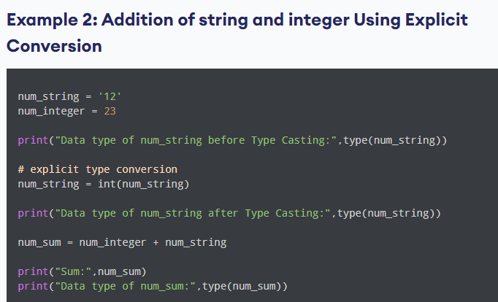

Explicit Conversion

Slide 20
Python Operators
What are Python Operators?
An operator is used to perform specific mathematical or logical operation on values.
The values that the operators work on are called operands.

Slide 21
Python Operators
Arithmetic Operator: +, -, *, /
Relational Operator: ==, >, <, !=, >=, <=
Assignment Operator: =, +=, -=
Logical Operator: and , or, not
Membership Operator: in, not in

Slide 22
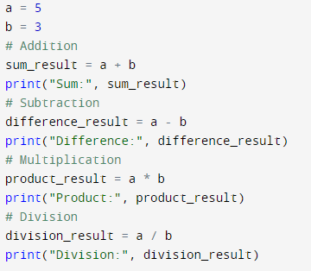
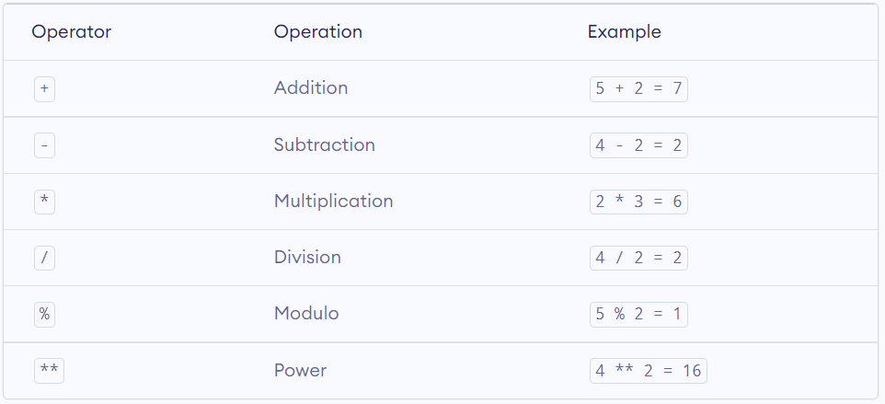

Arithmetic Operator

Slide 23
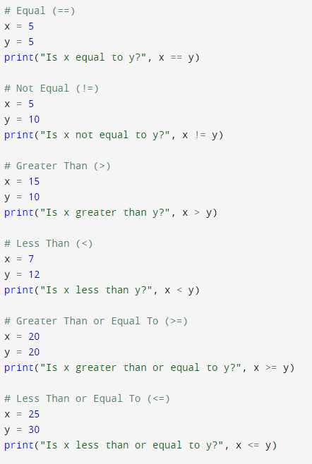
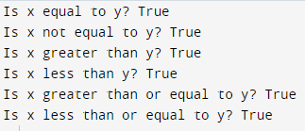
Comparison Operator

Slide 24
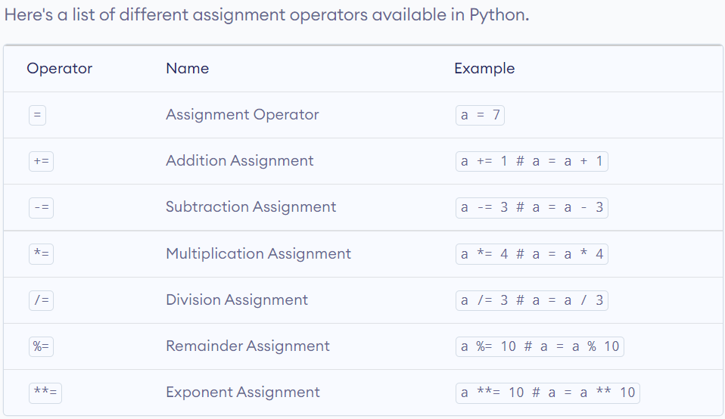
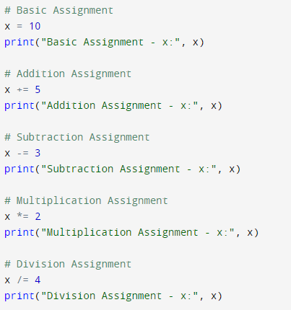
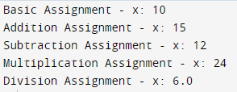
Assignment Operator

Slide 26
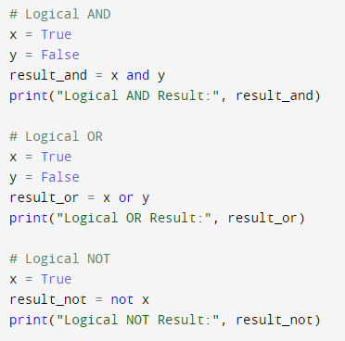
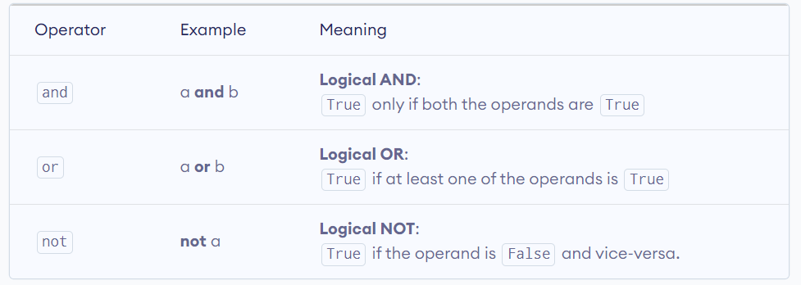

Logical Operator

Slide 27
Expressions
What are Expressions?
An expression is defined as combination of constants, variables, and operators. An expression always evaluates to a value.
For example: 100, num, num – 20.4, 3.0 + 3.14 and so on.
An Experession can contain sub expression within itself

Slide 28
REMEMBER!!!
WHAT IS BODMAS?
BODMAS IS AN ACRONYM TO HELP EVERYONE TO REMEMBER THE PRECEDENCE OF MATHEMATICAL OPERATIONS!!
IN PROGRAMMING LANGUAGES, OPERATORS HAVE DIFFERENT LEVELS OF PRECEDENCE, WHICH DETERMINES THE ORDER IN WHICH OPERATIONS ARE PERFORMED IN AN EXPRESSION.
https://docs.python.org/3/reference/expressions.html#operator-precedence

Slide 29
PYTHON INPUT AND OUTPUT

Slide 30
PYTHON INPUT AND OUTPUT
WE KNOW!!!
By now, we know, how to take input and how to display out.
There are two functions which are input and print!!
Further, we will look how to display output using format function.

Slide 31
Built-in Format Function
Formatted numeric string values are useful when displaying results in which only a certain number of decimal places need to be displayed:
Without use of format specifier:
>>> tax = 0.08
>>> print('Your cost: £', (1 + tax) * 12.99)
Your cost: £14.029200000000001
With use of format specifier:
>>> print('Your cost: £', format((1 + tax) * 12.99, '.2f'))
Your cost: £ 14.03
Finally, a comma in the format specifier adds comma separators to the result:
>>> format(13402.25, ',.2f')
13,402.25

Slide 32
Built-in Format Function
We can also use built-in function , format while displaying any string value.
For example, the following produces the string 'Hello' left-justified in a field width of 20 characters,
format('Hello', '<20') ➝ 'Hello '
To right-justify the string, the following would be used,
format('Hello', '>20') ➝ ' Hello'
Formatted strings are left-justified by default. Therefore, the following produce the same result,
format('Hello', '<20') ➝ 'Hello '
format('Hello', '20') ➝ 'Hello '

Slide 33
Escape/Control Characters
Newline (\n): This control character is used to start a new line.
print("Hello,\nworld!")
Output
Hello,
world!
Tab (\t): This control character is used to insert a tab space.
print("Name:\tJohn\nAge:\t35")
Output
Name: John
Age: 35
https://docs.python.org/3/reference/lexical_analysis.html#escape-sequences

Slide 34
TIME FOR BONUS

Slide 35
PYTHON COMMENTS
In computer programming, comments are hints that we use to make our code more understandable.
Comments are completely ignored by the interpreter. They are meant for fellow programmers.
We can use comments to document our program or code.
Comments are also used to identify errors and debugging

Slide 36
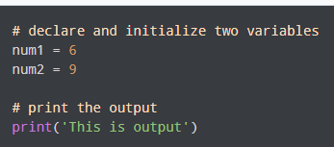

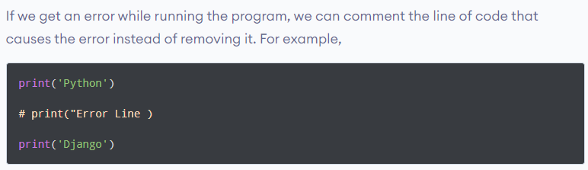
Comments Examples
Single line Comment Multiline
""" This is a multi-line comment with docstrings """
We can also use single quotes
‘’’ ……… ‘’’
Importance and uses of Comment
Make Code Easier to Understand
Comments used for Debugging

Slide 37
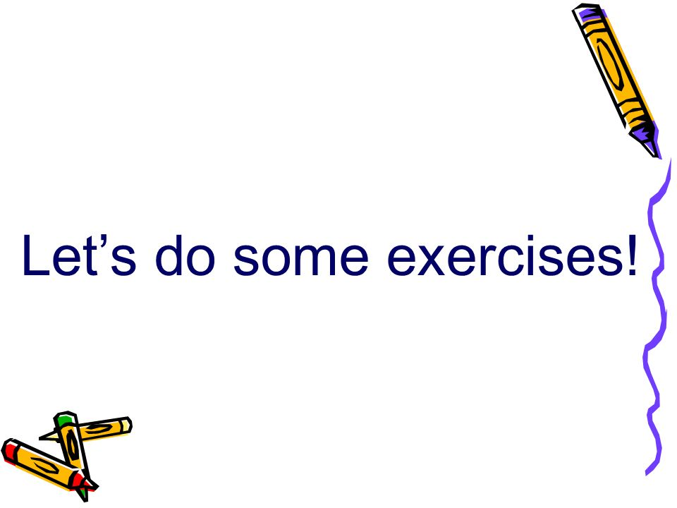

Slide 38
For You – Exercise
Write a program that asks the user to enter their name and age. Print a message addressed to the user that tells the user the year in which they will turn 100 years old.
2.The formula E = mc^2 states that the equivalent energy (E) can be calculated as the mass (m) multiplied by the speed of light (c = about 3×10⁸ m/s) squared. Write a program that accepts the mass of an object and determines its energy.
3. Write a program to enter two integers and perform all arithmetic operations on them. (Make a simple calculator)

Slide 39
For You – Additional Questions
Write a Python program to calculate the amount payable if money has been lent on simple interest. Principal or money lent = P, Rate of interest = R% per annum and Time = T years. Then Simple Interest
(SI) = (P x R x T)/ 100.
Amount payable = Principal + SI.
P, R and T are given as input to the program.
Write a Python program to convert temperature in degree Celsius to degree Fahrenheit. If water boils at 100 degree C and freezes as 0 degree C, use the program to find out what is the boiling point and freezing point of water on the Fahrenheit scale.
(Hint: T(°F) = T(°C) × 9/5 + 32)

Slide 40
For You – Home task
Suppose we have a program that asks the user to enter their weight in pounds and their height in inches, and then calculates their body mass index (BMI) using the formula:
BMI = (weight in pounds * 703) / (height in inches)^2
However, the program is designed to only accept weight and height inputs as floating-point numbers, but the user accidentally enters their weight as an integer and their height as a string.
To handle this scenario, we can use implicit and explicit type conversion, as well as some simple operators, to convert the user's inputs to the correct data types and perform the necessary calculations.

Slide 41


